Slide 1
Molecular Profiling of MPA/DMBA Induced Mouse Mammary Tumors
Christian Fougner
26.01.2017

Slide 2
Mouse Models of Cancer
Two main categories:
Genetically engineered mouse models of cancer
Chemically induced mouse models of cancer
Debate regarding the validity of chemically induced models of cancer
Aim: characterize MPA/DMBA-induced mammary tumors as a model for human breast cancer

Slide 3
MPA/DMBA Induced Carcinogenesis
DMBA: 7,12-Dimethylbenz[a]anthracene
Polycyclic aromatic hydrocarbon
Carcinogen
DNA damage by formation of DMBA/DNA adducts
Immunosuppressive effect
Exposure through tobacco smoke, diet and occupational exposure (aluminum production, fossil fuel processing)
MPA: Medroxyprogesterone acetate
DMBA chemical structure. Public domain.

Slide 4
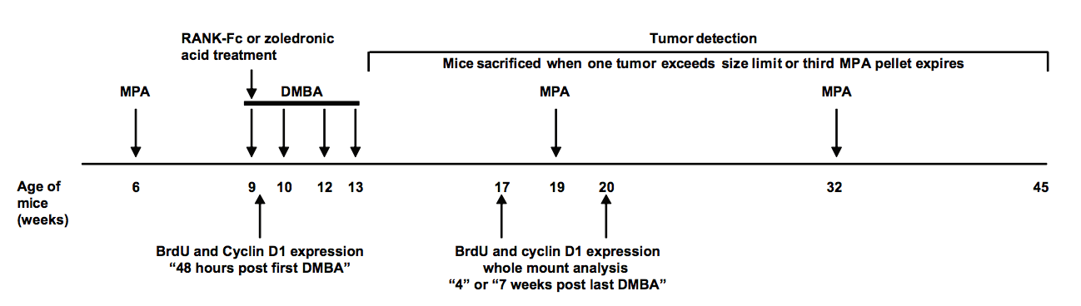
MPA/DMBA protocol
*Gonzalez-Suarez, E., et al., RANK ligand mediates progestin-induced mammary epithelial proliferation and carcinogenesis. Nature, 2010. 468(7320): p. 103-107.

Slide 5
MPA/DMBA Induced Carcinogenesis
66 mice treated
18 mice developed tumors
Mice developing tumors sacrificed at average age of 186 days (26 weeks, 4 days)
Multiple mammary tumors in 4 mice
18 tumors from 14 mice included in further analysis

Slide 6
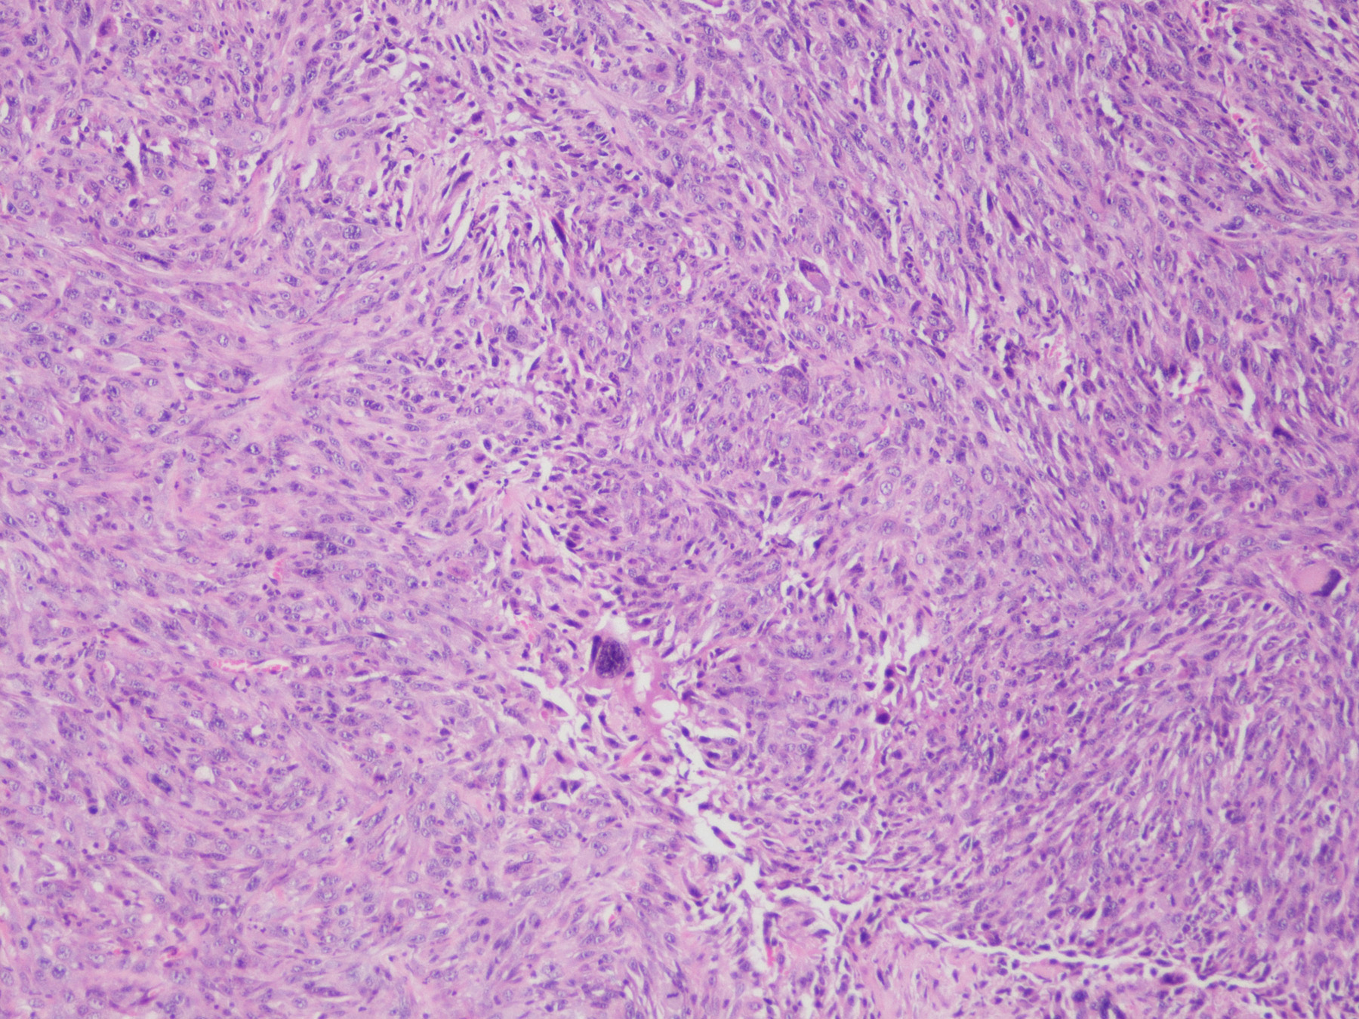
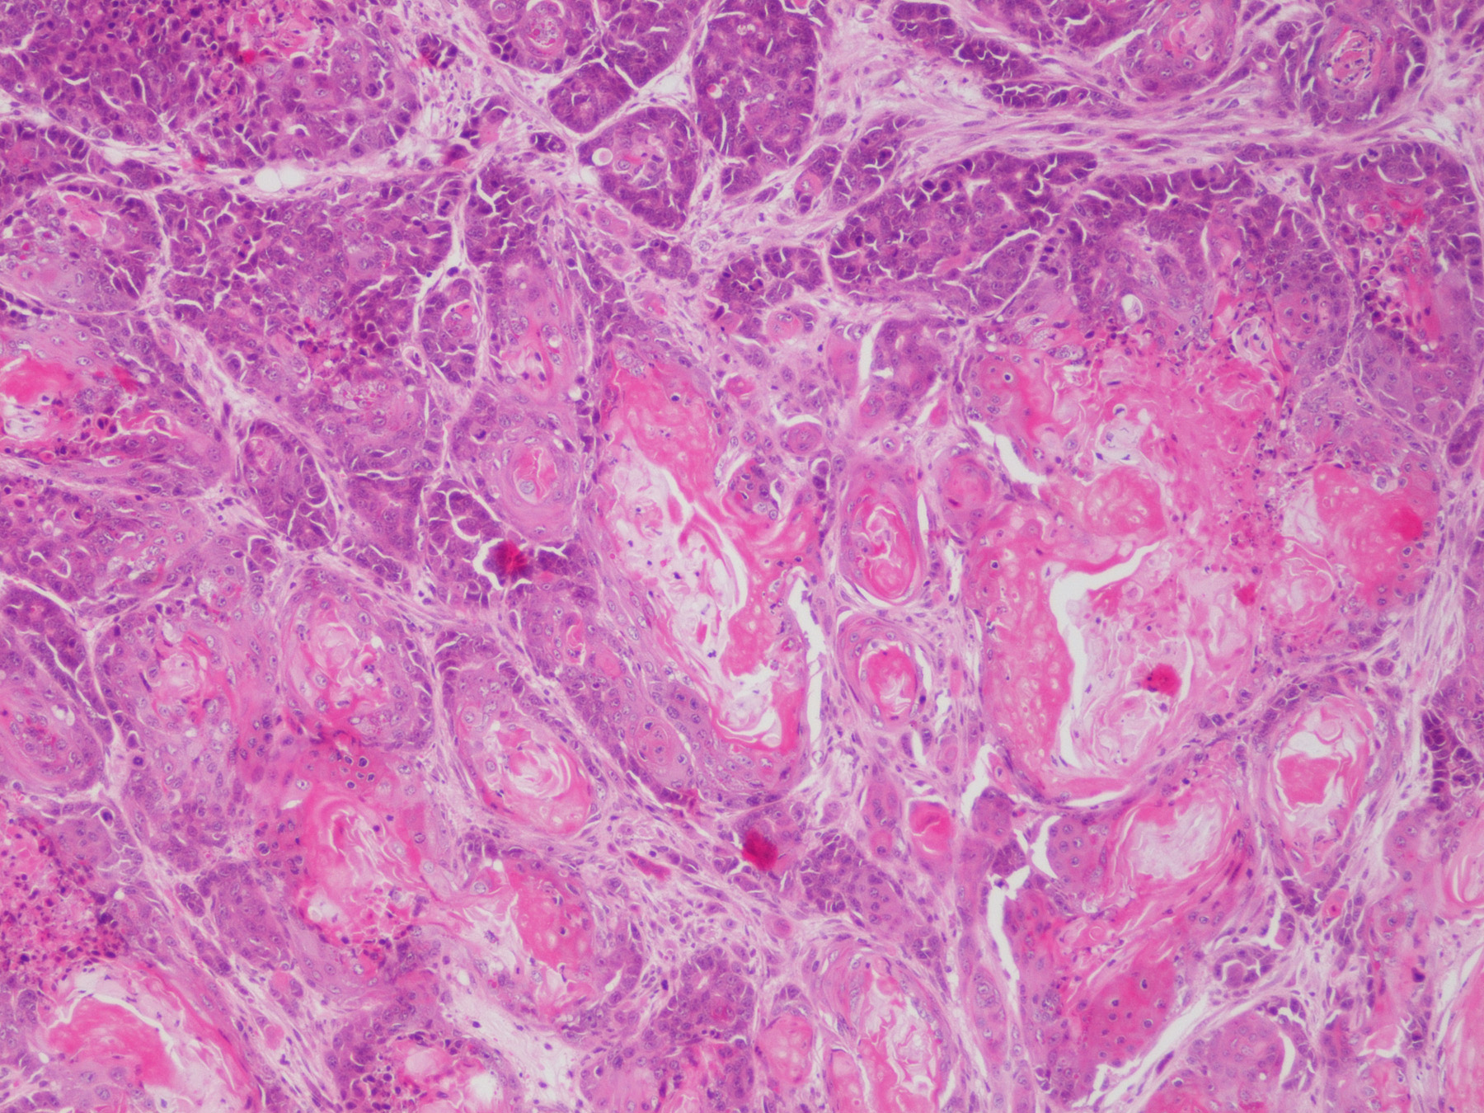
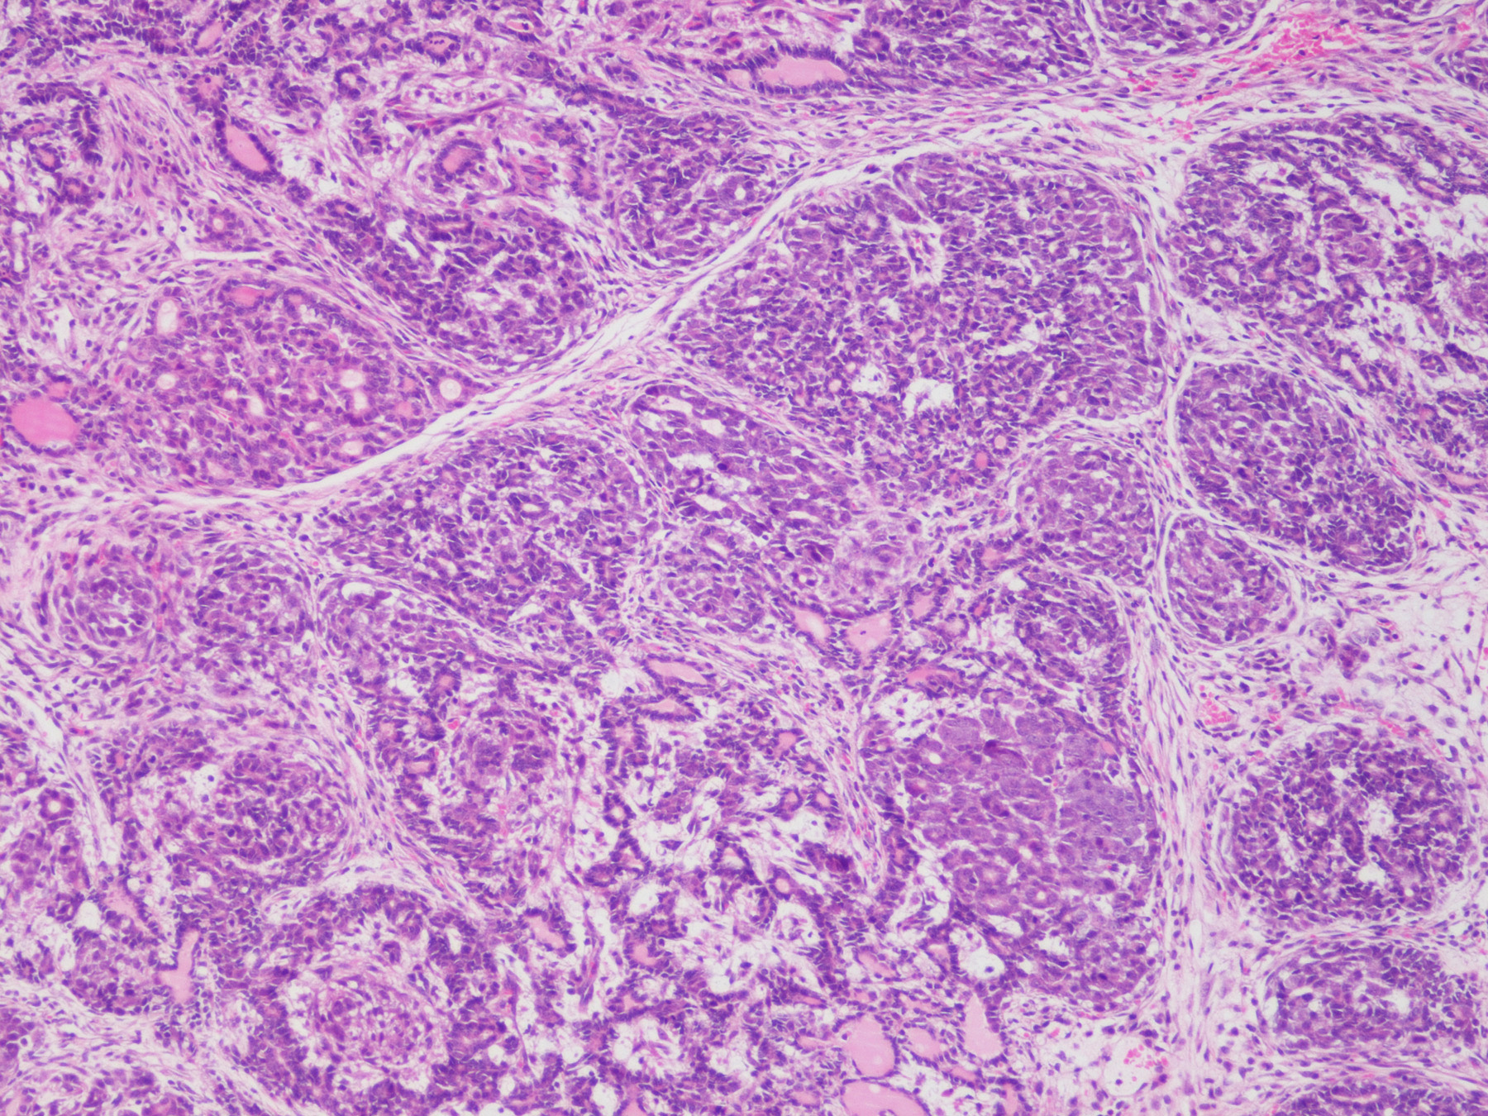
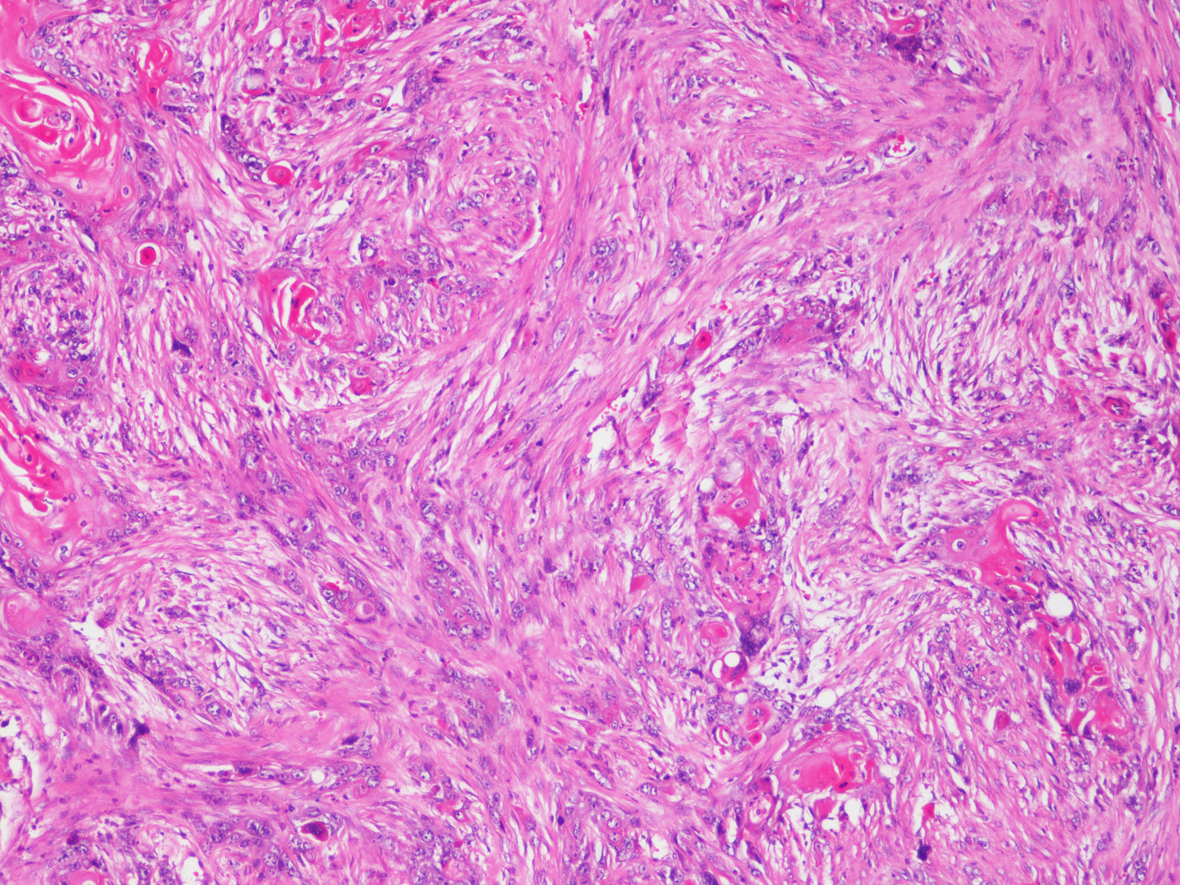
Histology
Histologically heterogeneous
Frequent cornification
Spindle cell components (6/18 tumors)
Squamous cell carcinoma characteristics (4/18 tumors)
Inflammatory features

Slide 7
Immunohistochemical staining
Sample | K5 | K18 | Ki67 (%)
S123_14_6 | Positive | Mixed | 9
S131_14_9 | Positive | Negative | 48
S132_14_5 | Positive | Negative | 40
S153_14_2 | Negative | Positive | 28
S159_14_2 | Negative | Mixed | 19
S159_14_8 | Negative | Negative | 8
S160_14_2 | Mixed | Positive | 27
S176_14_2 | Negative | Positive | 39
S187_14_1 | Mixed | Positive | 47
S189_14_2 | Mixed | Negative | 20
S189_14_4 | Negative | Negative | 20
S400_15_2 | Positive | Negative | 18
S400_15_7 | Positive | Negative | 30
S401_15_2 |  | Negative | 25
S412_15_2 |  | Positive | 41
S416_15_2 |  | Negative | 4
S416_15_13 |  | Mixed | 18
S422_15_2 |  | Negative | 2
K5 = Basal marker
K18 = Luminal marker
Ki67 = proliferation marker
Heterogeneous expression of immunohistochemical markers

Slide 8
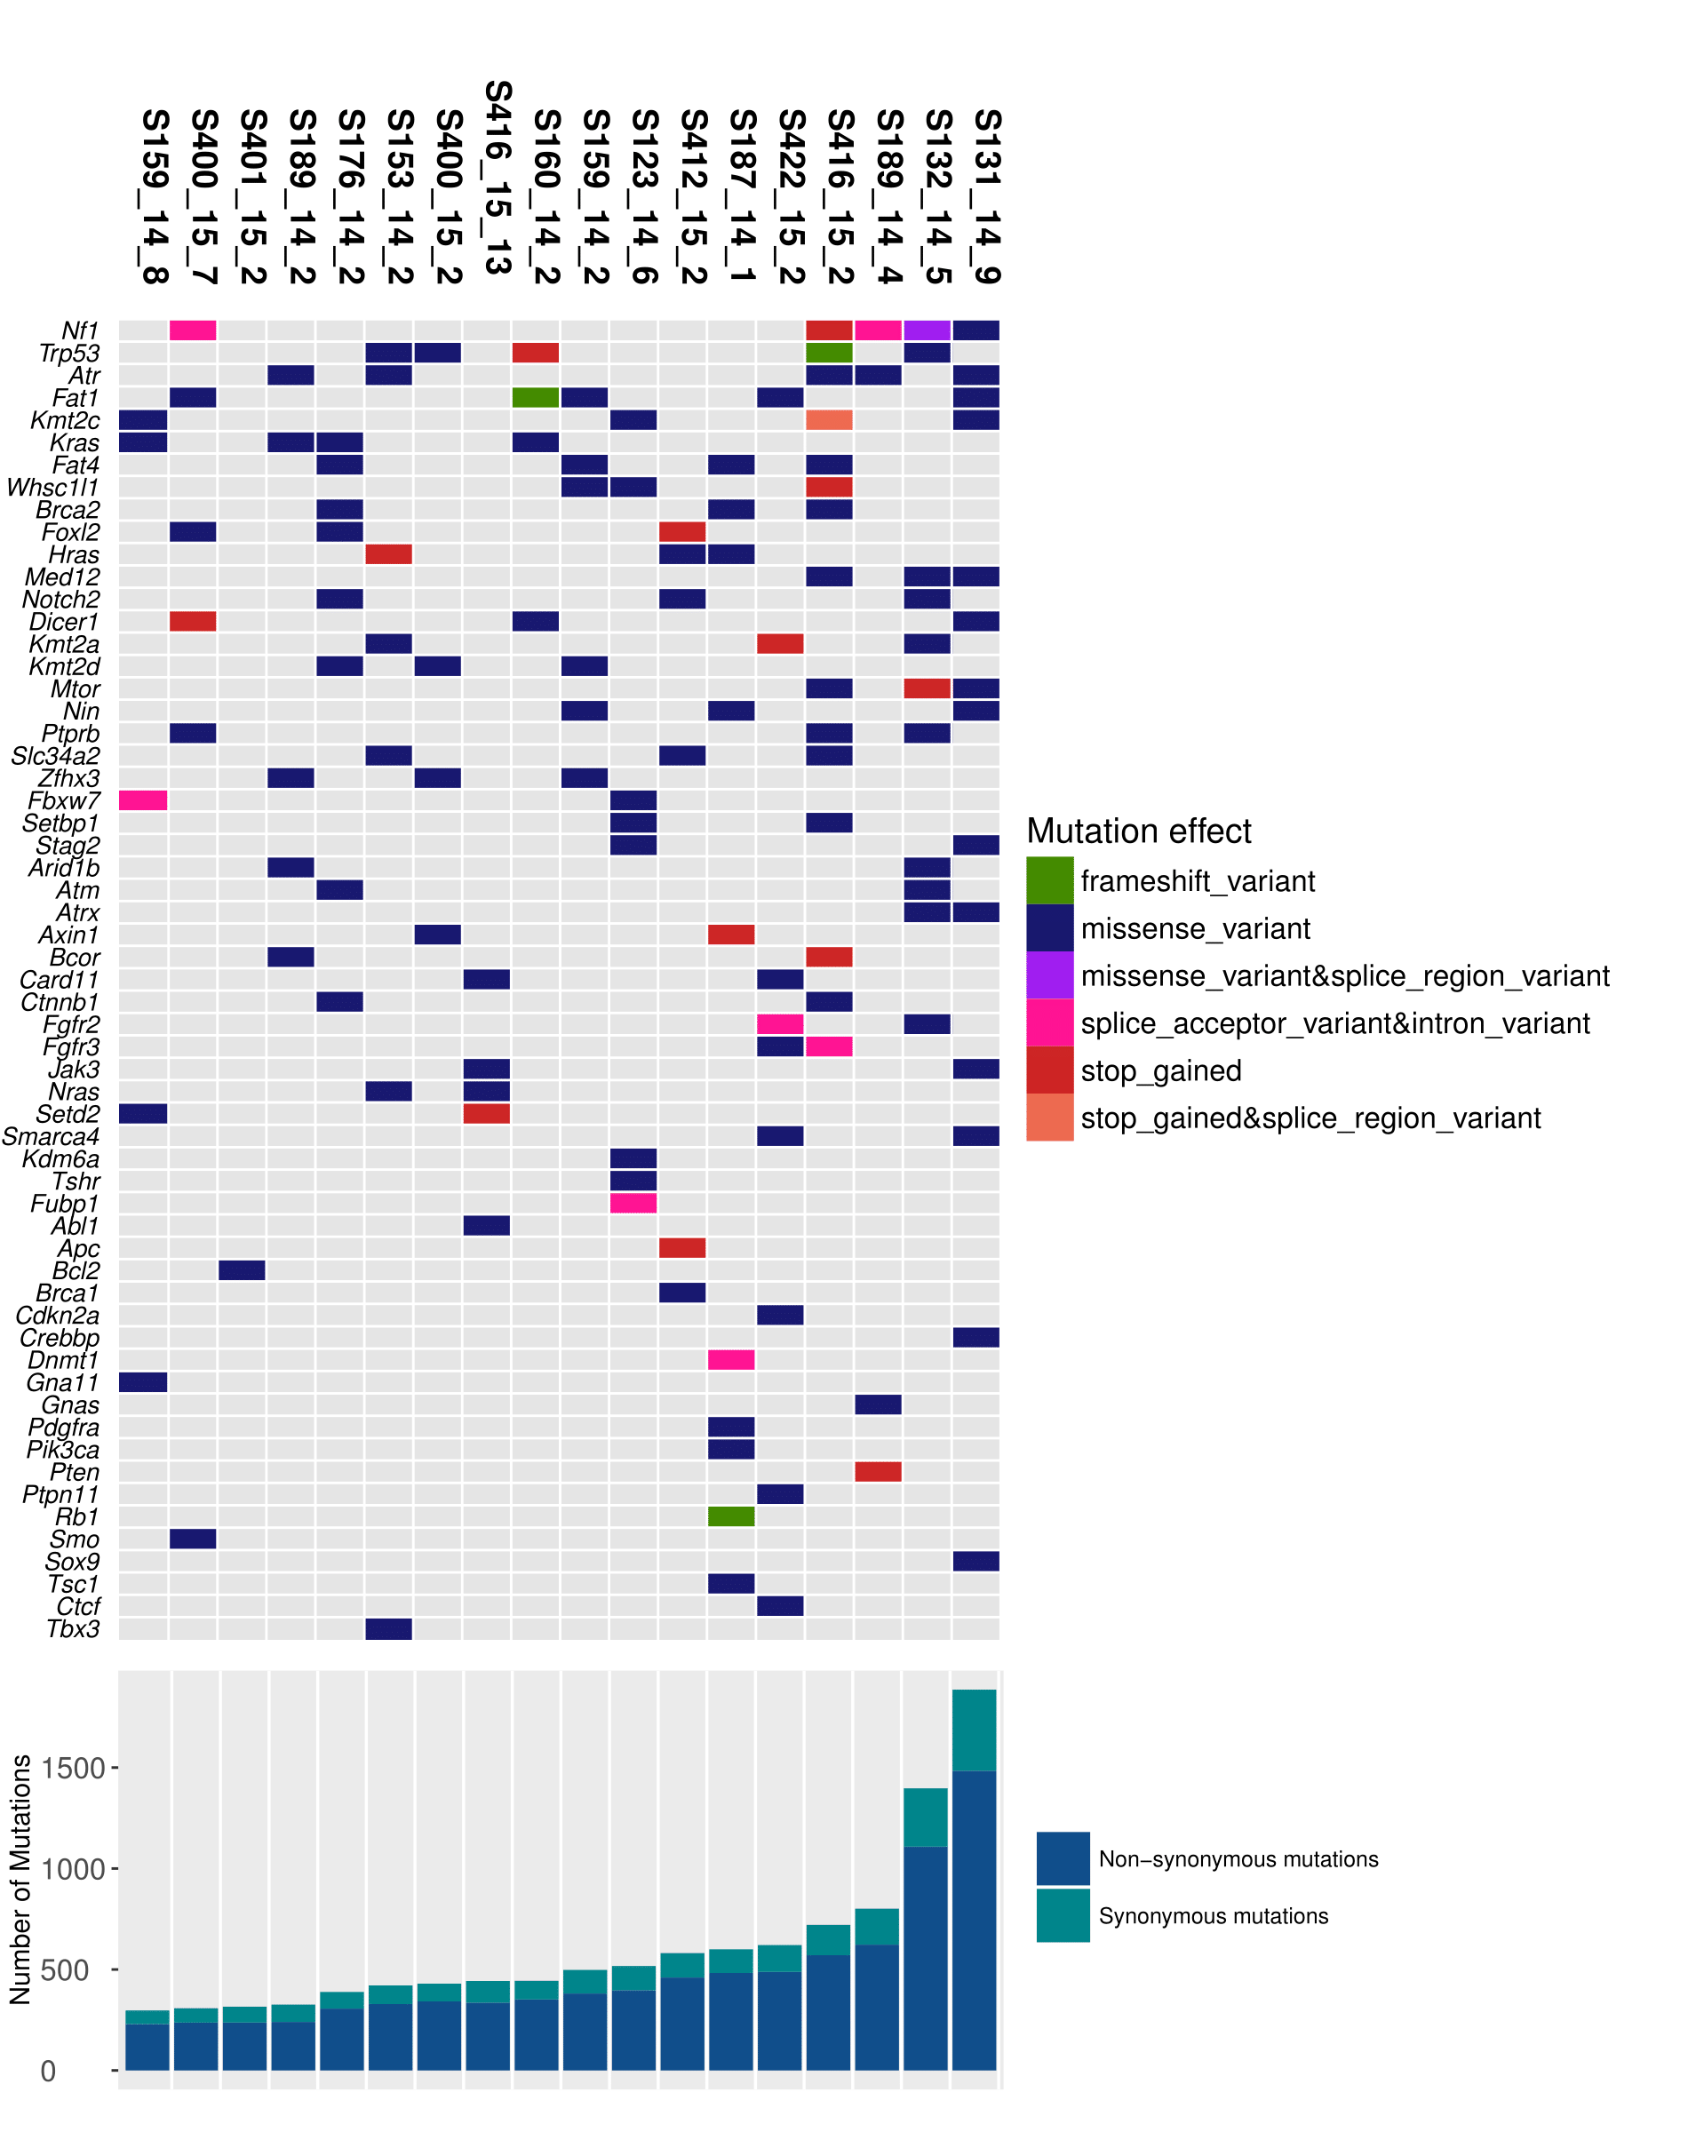
Whole exome sequencing: mutations
292 – 1861 mutations per tumor (median = 469)
Mutation rate: 5.89 – 37.52/MB (median = 9.46/MB)
Human breast cancer: 1.31/MB
Most frequently mutated candidate driver genes:
Nf1 (5/18, 28%)
Trp53 (5/18, 28%)
Atr (5/18, 28%)
Fat1 (5/18, 28%)
Kras (4/18, 22%)
Kmt2c(4/18, 22%)
Fat4 (4/18, 22%)

Slide 9
Mutations
Note: p-values not yet corrected for multiple hypothesis testing
Gene | Number of mutations found in TCGA data (n=817) | Percent mutated | Number of mutated in DMBA induced (n=18) | Percent mutated | p-value
PIK3CA | 282 | 34.5% | 1 | 5.6 % | 0.010*
TP53 | 280 | 34.3% | 5 | 27.8 % | 0.627
KMT2C | 62 | 7.6% | 4 | 22.2 % | 0.047*
MUC4 | 50 | 6.1% | 3 | 16.7 % | 0.100
MUC12 | 47 | 5.8% | 1 | 5.6 % | 1.000
PTEN | 42 | 5.1% | 1 | 5.6 % | 0.618
FLG | 41 | 5.0% | 1 | 5.6 % | 0.609
SYNE1 | 41 | 5.0% | 1 | 5.6 % | 0.609
DMD | 33 | 4.0% | 3 | 16.7 % | 0.038*
SPEN | 32 | 3.9% | 1 | 5.6 % | 0.520
SPTA1 | 30 | 3.7% | 1 | 5.6 % | 0.497
FAT3 | 30 | 3.7% | 4 | 22.2 % | 0.005*
OBSCN | 28 | 3.4% | 5 | 27.8 % | <0.001*
TBX3 | 27 | 3.3% | 1 | 5.6 % | 0.462
NCOR2 | 27 | 3.3% | 1 | 5.6 % | 0.462
KMT2D | 25 | 3.1% | 3 | 16.7 % | 0.020*
NF1 | 24 | 2.9% | 5 | 27.8 % | <0.001*
RELN | 22 | 2.7% | 5 | 27.8 % | <0.001*
NOTCH2 | 21 | 2.6% | 3 | 16.7 % | 0.013*
PCLO | 21 | 2.6% | 6 | 33.3 % | <0.001*
64 of 100 most frequently mutated genes in human breast cancer were mutated in cohort of 18 MPA/DMBA-induced tumors
39 of 64 found to be mutated at similar rates (p>0.05) to human BC
24 of 64 found to be mutated at higher rates than human BC (p<0.05)
Infrequently mutated in MPA/DMBA-induced tumors:
PIK3CA (1/18 =5.5% vs. 34.5% in human BC)
CDH1 (0% vs. 13.1% in human BC)
GATA3 (0% vs. 11.75% in human BC)
Map3k1 (0% vs. 8.45% in human BC)

Slide 10
Mutation spectra
Homogenous mutation spectra
T>A transversions represent 62.6% of all mutations
C>A transversions represent 16.8% of all mutations

Slide 11
Mutation Spectra
Of all T>A transversions 60.9% have a 3’ guanine
Homogeneous mutation spectra across cohort

Slide 12
Mutational Signatures
Sample | Signature 4 | Signature 22 | Signature 25
S123_14_6 | 0 % | 70.9 % | 20.6 %
S131_14_9 | 19.8 % | 68.7 % | 11.5 %
S132_14_5 | 16.3 % | 67.8 % | 15.9 %
S153_14_2 | 22.6 % | 64.9 % | 10.1 %
S159_14_2 | 28.5 % | 67.3 % | 0 %
S159_14_8 | 26.7 % | 66.6 % | 0 %
S160_14_2 | 28.1 % | 66.8 % | 0 %
S176_14_2 | 16.8 % | 58.2 % | 20.6 %
S187_14_1 | 13.3 % | 82.2 % | 0 %
S189_14_2 | 18.9 % | 62.5 % | 13.9 %
S189_14_4 | 16.6 % | 74.3 % | 8 %
S400_15_2 | 32 % | 61.7 % | 6.3 %
S400_15_7 | 24.1 % | 75.3 % | 0 %
S401_15_2 | 0 % | 63.9 % | 25.4 %
S412_15_2 | 14 % | 79.9 % | 6 %
S416_15_2 | 23.7 % | 71 % | 0 %
S416_15_13 | 21.5 % | 62.2 % | 14 %
S422_15_2 | 31.3 % | 64.1 % | 0 %
Signature 4
Assoaciated with smoking and tobacco carcinogens (f.ex. benzo[a]pyrene]
Found in head and neck, liver, lung, and esophageal cancer
Signature 22:
Associated with exposure to aristocholic acid
Found in urothelial carcinoma and liver cancer
Signature 25:
Unknown etiology
Found in Hodgkin lymphomas

Slide 13
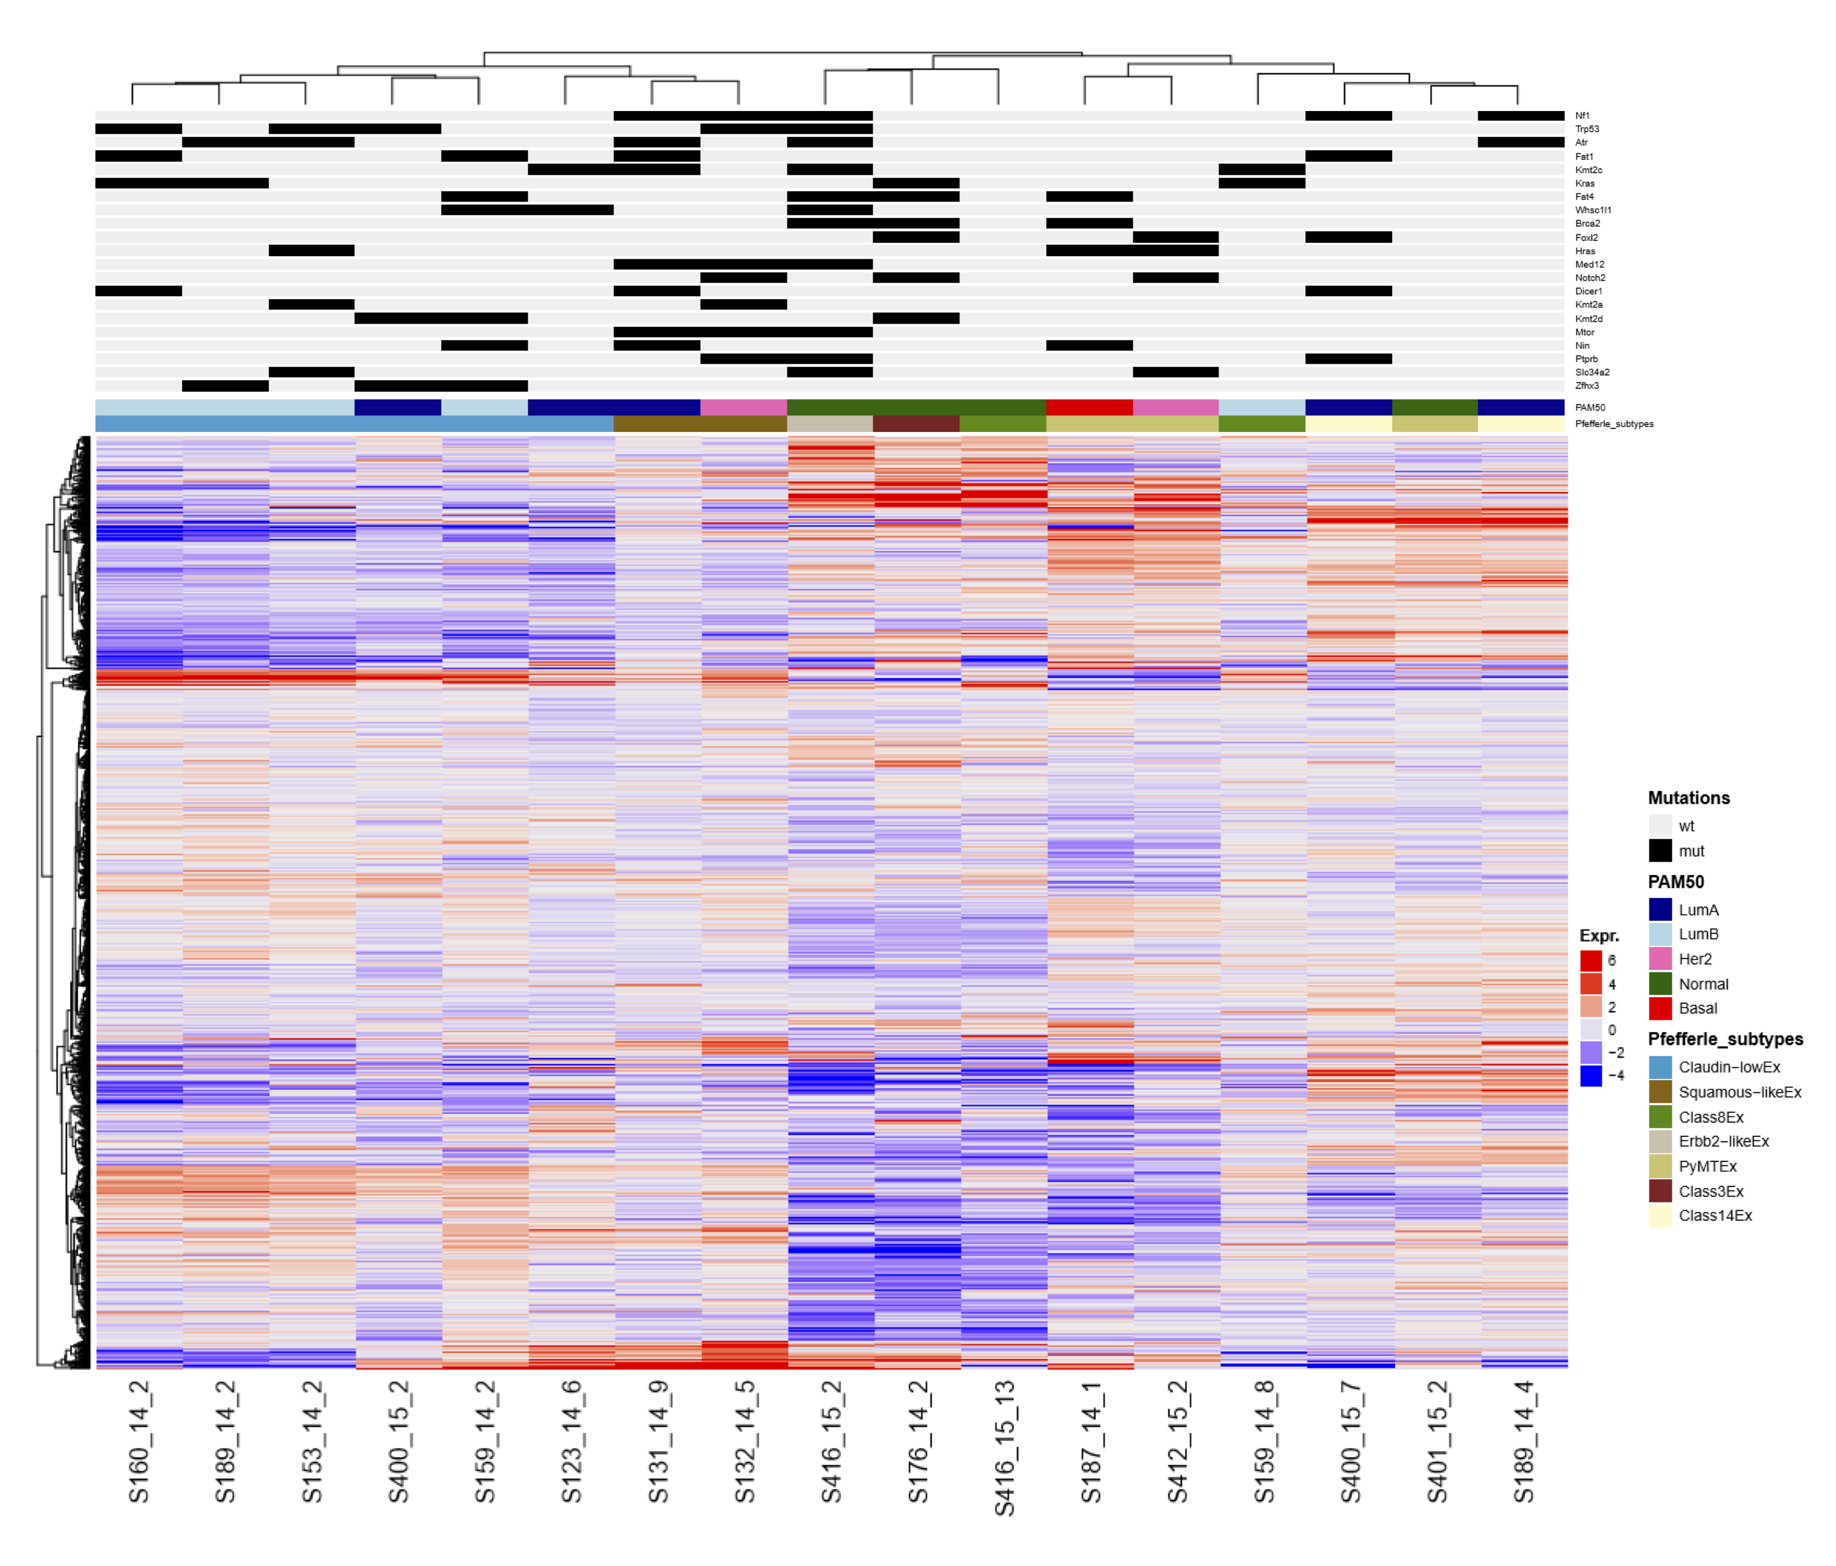
Gene Expression Analysis
PAM50 subtypes
“Genefu” R-package
All subtypes represented
LumA & LumB most frequent
Murine subtypes
Integrated analysis of murine subtypes by C. Perou group
Mouse intrinsic gene list
Two major clusters in our data
Cluster 1: Claudin-low & squamous like
Cluster 2: Heterogeneous

Slide 14
Summary
MPA/DMBA-induced mammary tumors:
are histologically heterogeneous
frequently display mutations in genes mutated in human breast cancer
frequently display mutations in genes NOT mutated in human breast cancer
a subset may represent a useful model for Claudin-low breast cancer

Slide 15
Acknowledgements/Collaborators
Therese Sørlie
Jens Henrik Norum
Helga Bergholtz
Anna Polec
Per Ekstrøm
Raoul Kuiper
Chuck Perou
Cheng Fan
Forskerlinjen/Medical Student Research Program

